Slide 1
CSE-3108 Spring, 2016 Interfacing with 7-Segment FND through 8255

Slide 2
Task: Write a Program to display the digits in decimal from 0-7
Objective: Write a program to display the digits in decimal, from 0-7 into 7-segment.
7-Segment Display
The 7 segment FND(Flat Numeric Display) inside the MDA – 8086 trainer kit can be used to display numbers.
This requires PIO-8255 ports which are already connected to the 7 segment internally. You don’t have to manually setup a connection between the FND and 8255A
By executing proper instructions, we can access these ports and provide binary or hex value to switch the required segment on and off.
The 7-segment display is a common anode display. Hence the segments are active low. In order to turn a segment ON, we need to set logical 0 at the corresponding port.

Slide 3
Introduction to 8255
The Intel 8255 Programmable Peripheral Interface (PPI) chip is a peripheral chip originally developed for the Intel 8085 microprocessor
8255 has 40 pins in total, for interfacing with other devices, power supply, chip select etc.
24 of these pins are intended towards I/O operations
These pins are divided intro three 8-bit ports[Port A, Port B, Port C]
Port A, Port B can be used as 8-bit I/O ports
Port C can either be used as a 8-bit I/O port, or two 4-bit I/O ports.
Port C can also be used for producing handshaking signals during handshake data transfer

Slide 4
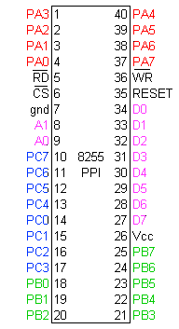
8255A ports

Slide 5
Introduction to 8255
The three ports are further grouped as follows-
Group A : Port A and upper part of Port C
Group B: Port B and lower part of Port C
8255 contains four registers. One for each of Port A, B, C; and another one called ‘Control Word Register’(CWR) for storing the current control state of 8255. CWR stores bits which denote information like whether Port A, Port B, Port C upper or Port C lower are in input mode or output mode.
Eight data lines (D0-D7) are available (with an 8-bit data buffer) to read/write data into the ports or control register
The address lines A1 and A0 allow to successively access any one of the ports or the control register
Port A, B, C are connected with external devices, and data lines(D0-D7) and address lines(A0, A1) are connected with the microprocessor

Slide 6
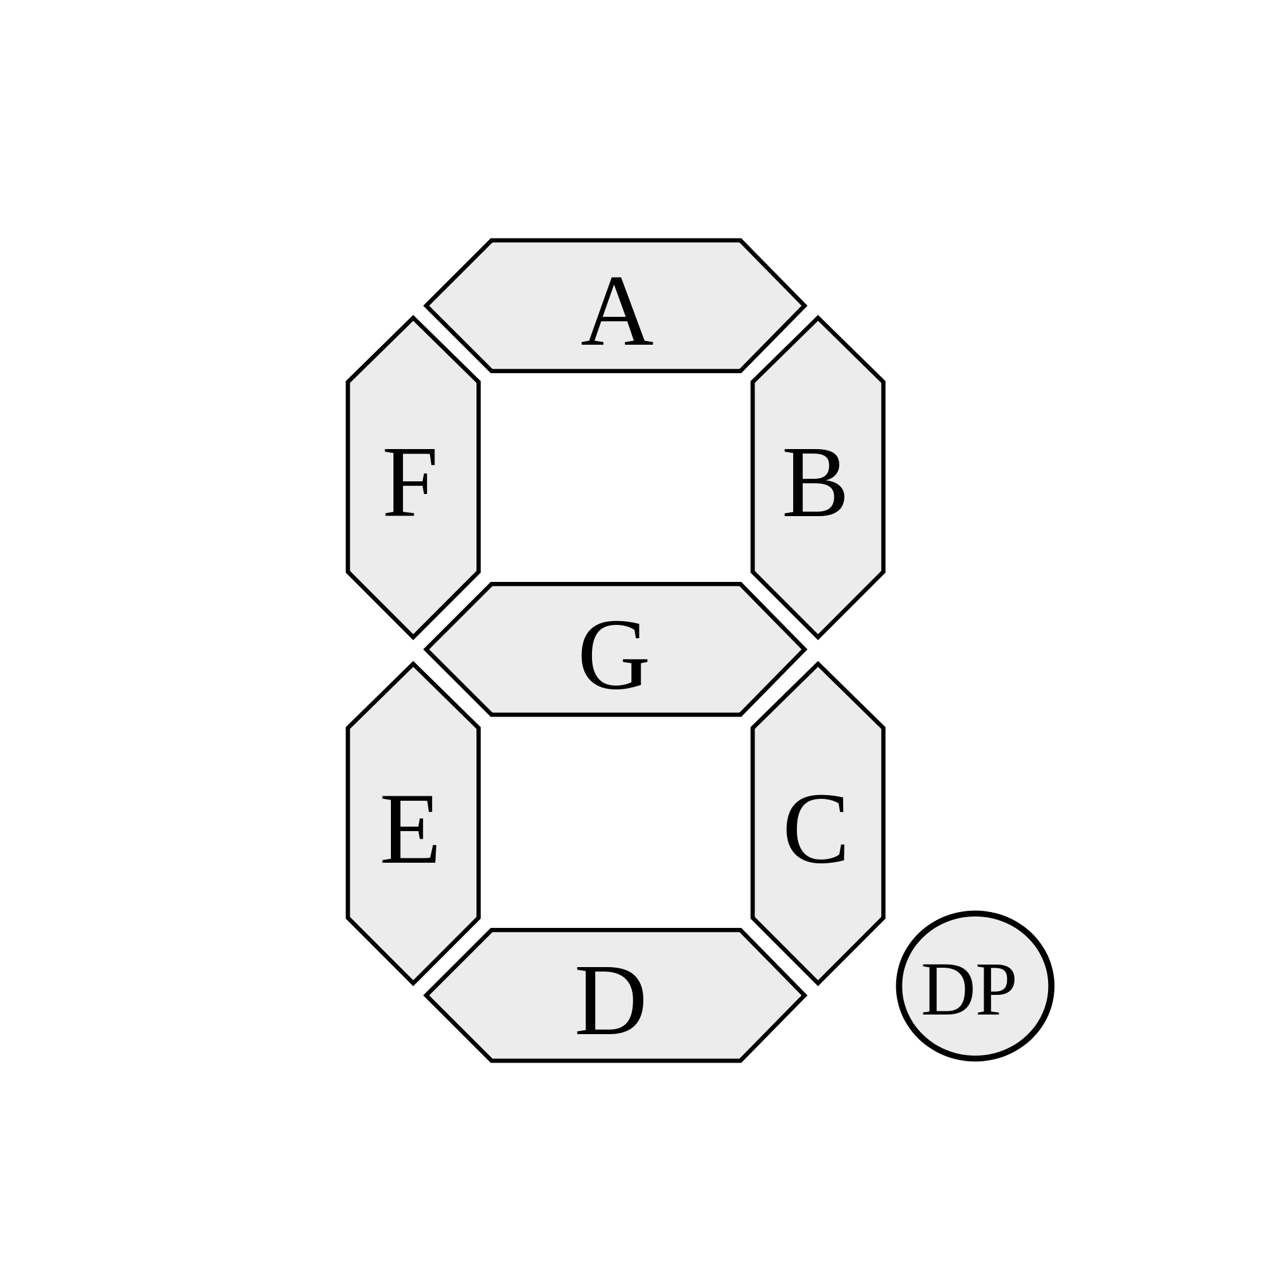
Segment Labels of a 7-segment Display

Slide 7
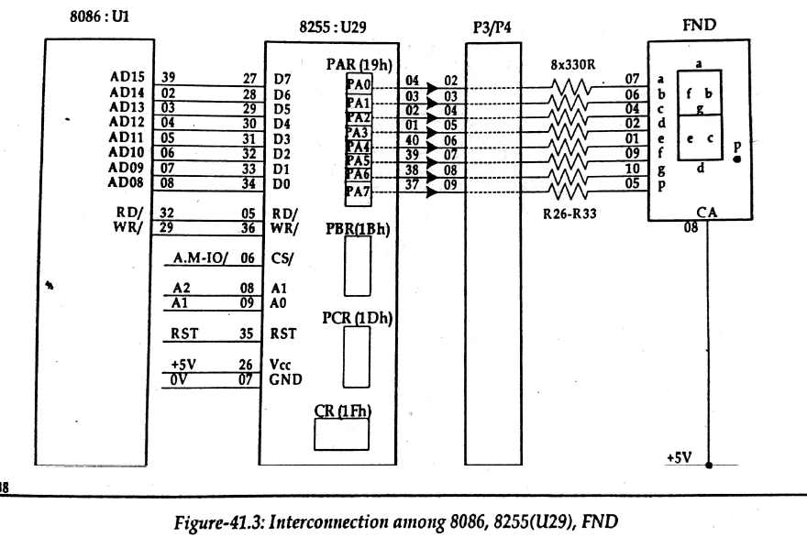

Slide 8
Write a Program to display the digits in decimal from 0-7
It’s obvious from the last slide that we have to output a specific value to Port A to display a specific number
Hence, Port A must be in output mode
Thus, initially, we have to send a control word to the control register to set Port A in output mode
How do we do that?
We have to send a proper mode definition control word to the control register. Now Port A is in output mode
After that, we can output anything to Port A and light the segments of FND correspondingly

Slide 9
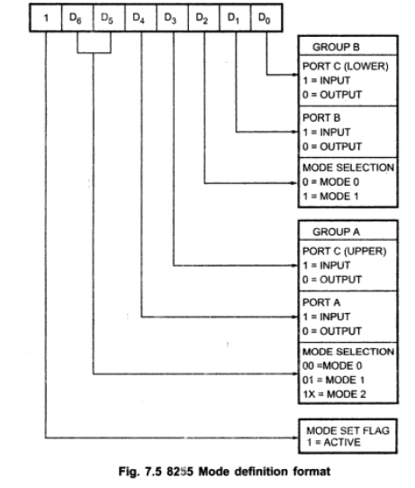

Slide 10
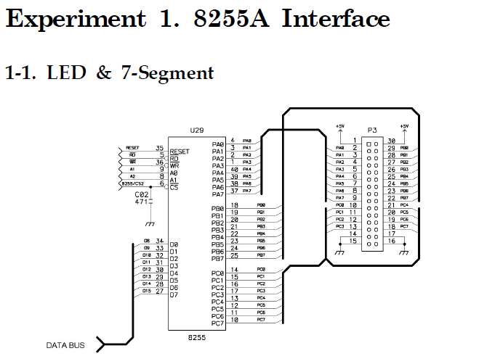

Slide 11
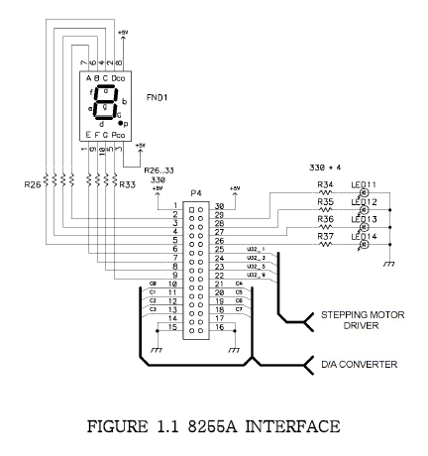

Slide 12
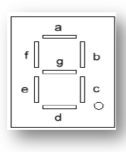
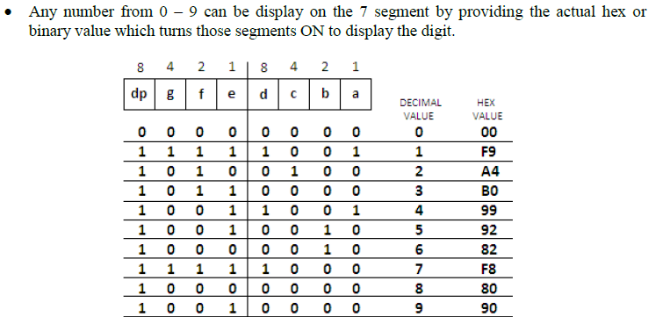

Slide 13
Task 1 - Display the digit 5 on the FND
Try out the following code

Slide 14
CODE SEGMENT
ASSUME CS:CODE
PPI_Control EQU 1FH ; 'EQU' is similar to macro in C
PPIA EQU 19H
ORG 1000H
MOV AL, 10000000B
OUT PPI_Control, AL ; Now PortA is in output mode
MOV AL, 92H ; The bitmask for the digit 5
OUT PPIA, AL ; Display the digit!
INT 3
CODE ENDS
END

Slide 15
Task 2 – Display the digits 0 through 9 in a loop
Store the bitmasks for displaying the numbers from 0 to 9 starting from address 1000:0000 through 1000:0009
Bitmasks : C0, F9, A4, B0, 99, 92, 82, F8, 80, 90
Then write a program that displays the digits 0 through 9 in the 7 segment FND using the bitmasks currently stored in the RAM

Slide 16
CODE SEGMENT
ASSUME CS:CODE
PPI_Control EQU 1FH
PPIA EQU 19H
ORG 1000H
MOV AL, 10000000B
OUT PPI_Control, AL
MOV AX, 1000H
MOV DS, AX
L2: MOV SI, 0H ; Now, DS:SI = 10000:0000
MOV CX, 0AH
L1: MOV AL, BYTE PTR DS:[SI]
CMP CX, 00H
JE L2
OUT PPIA, AL
CALL TIMER
INC SI
DEC CX
JMP L1
INT 3
; Write the TIMER procedure now
TIMER: PUSH CX
MOV CX, 1000H
TIMER1: NOP
LOOP TIMER1
POP CX
RET
CODE ENDS
END

Slide 17
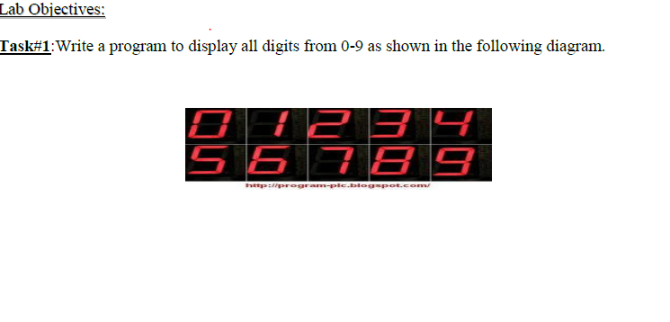
Result

Slide 18
Practice
Display the numbers in a reverse manner, from 9 down-to 0, then 9 again.

